Slide 1
Item Discrimination Power

Slide 2
What is Discrimination power?
The word Discrimination means:
Recognition and understanding of the difference between one thing and another
The ability to judge what is of high quality; good judgement or taste

Slide 3
Discrimination Power
The Discrimination Power of a test item is its ability to differentiate between good (H) and poor (L) students.

Slide 4
Purposes
Helps to check and improve the quality of items
Distinguish between good and weak students
Helps in preparing best test items

Slide 5
The process for determining item discrimination index is to subtract the proportion of correct responses in the low scoring group from that of the high scoring group. We can express it in a formula as :

Slide 6
Before going to the formula first we need to collect data required for the formula. We need to make Analysis working sheet as we prepare in item analysis.

Slide 7
Making item analysis worksheet
First score the test
Then arrange the test papers in descending order on the basis of marks (highest score to lowest score)
Select about one forth of the papers from highest scores and one forth from lowest scores.

Slide 8
Making item analysis worksheet
Now draw a table and write each item number and its response for each student in the form of correct (1) and wrong (0).

Slide 10
Now count the number of right responses in highest scoring group (H) and lowest scoring group (L) for each item.
Now subtract L from H.

Slide 12
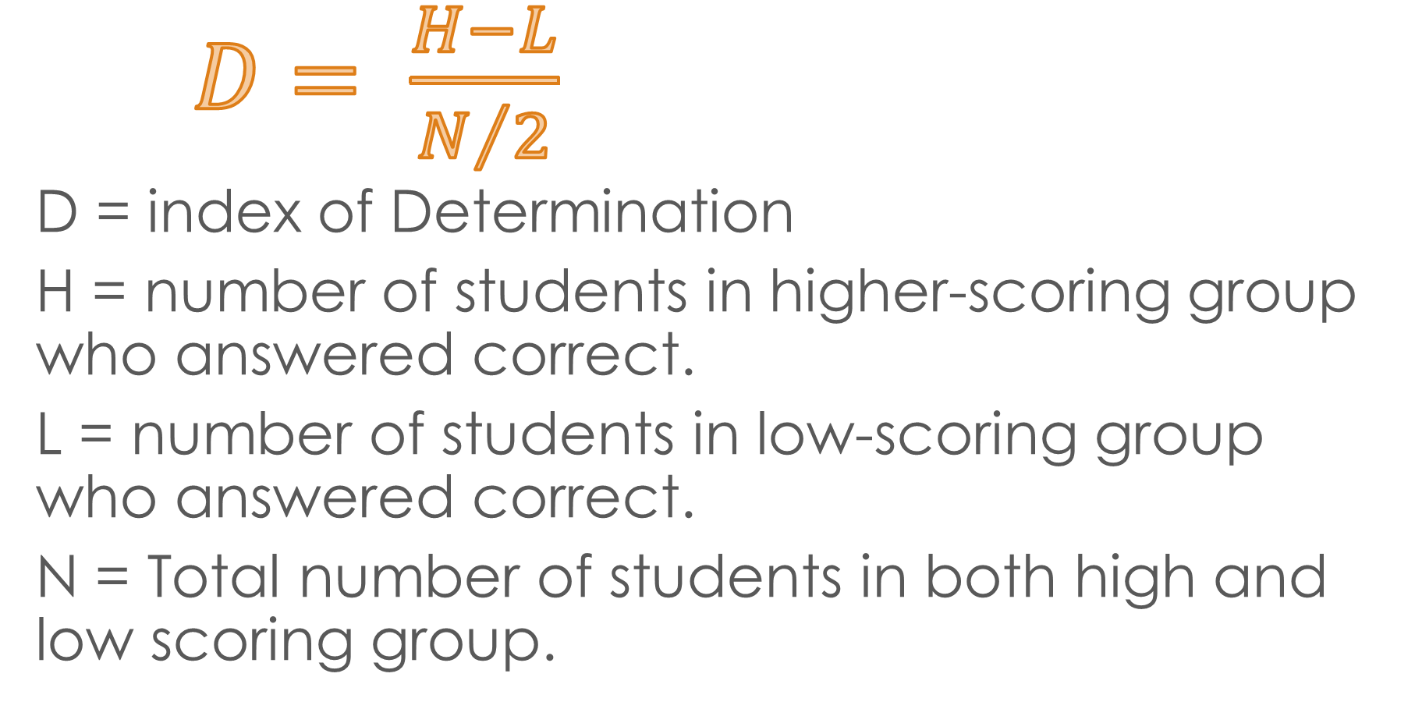
Discrimination Index Formula
$D= \frac{H−L}{N/2}$
D = index of Determination
H = number of students in higher-scoring group who answered correct.
L = number of students in low-scoring group who answered correct.
N = Total number of students in both high and low scoring group.

Slide 13
Now we can determine the Discrimination power of any item by this formula.
For example:
The D value for each item will be :

Slide 14
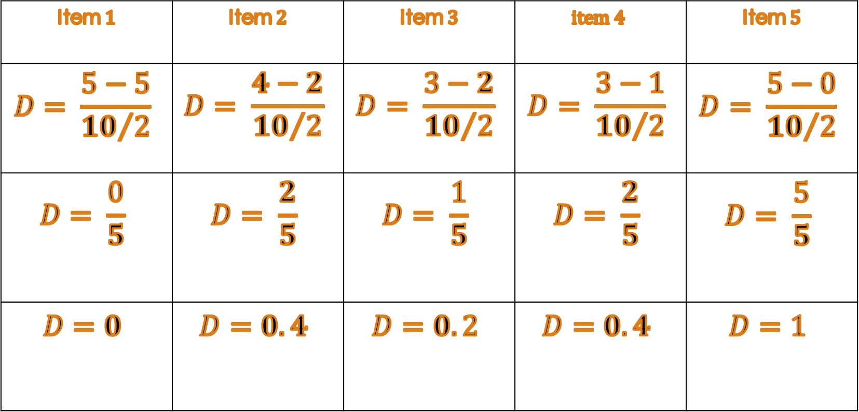
Item $1$ | Item $2$ | Item $3$ | $$item 4$$ | Item $5$
$$D= \frac{5−5}{{10}/2}$$ | $$D= \frac{4−2}{{10}/2}$$ | $$D= \frac{3−2}{{10}/2}$$ | $$D= \frac{3−1}{{10}/2}$$ | $$D= \frac{5−0}{{10}/2}$$
$$D= \frac{0}{5}$$ | $$D= \frac{2}{5}$$ | $$D= \frac{1}{5}$$ | $$D= \frac{2}{5}$$ | $$D= \frac{5}{5}$$
$$D=0$$ | $$D=0.4$$ | $$D=0.2$$ | $$D=0.4$$ | $$D=1$$

Slide 15
The index of item discrimination (D) vary from +1.00 through 0.00 to -1.00.
The maximum size of D is +1.00
The minimum size of D is -1.00
The D will be zero when from high or low group answers the item correctly or all of them answers correctly.

Slide 16
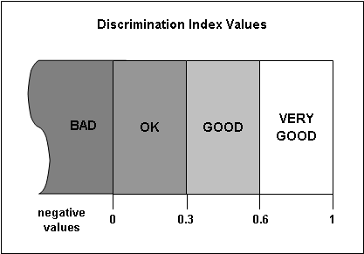
What is a “good” value?
For exams with a normal distribution, a discrimination of 0.3 and above is good; 0.6 and above is very good.
Values close to 0 mean that most students performed the same on an item.
The index should never be negative.

Slide 17
Another consideration for D
0.40 and greater are very good
0.30 to .39 are reasonably good
0.20 to .29 are marginal items and need some revision,
0.19 and below are considered poor items

Slide 18
The larger the D value the better the item will be. For the purpose of classroom testing we can accept an item whose D value is not below +0.20

